Slide 1
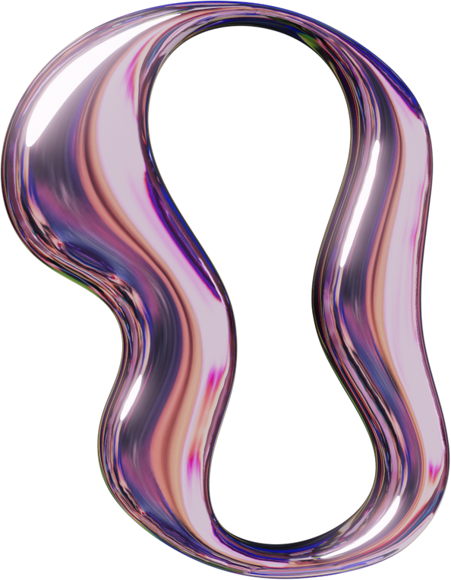
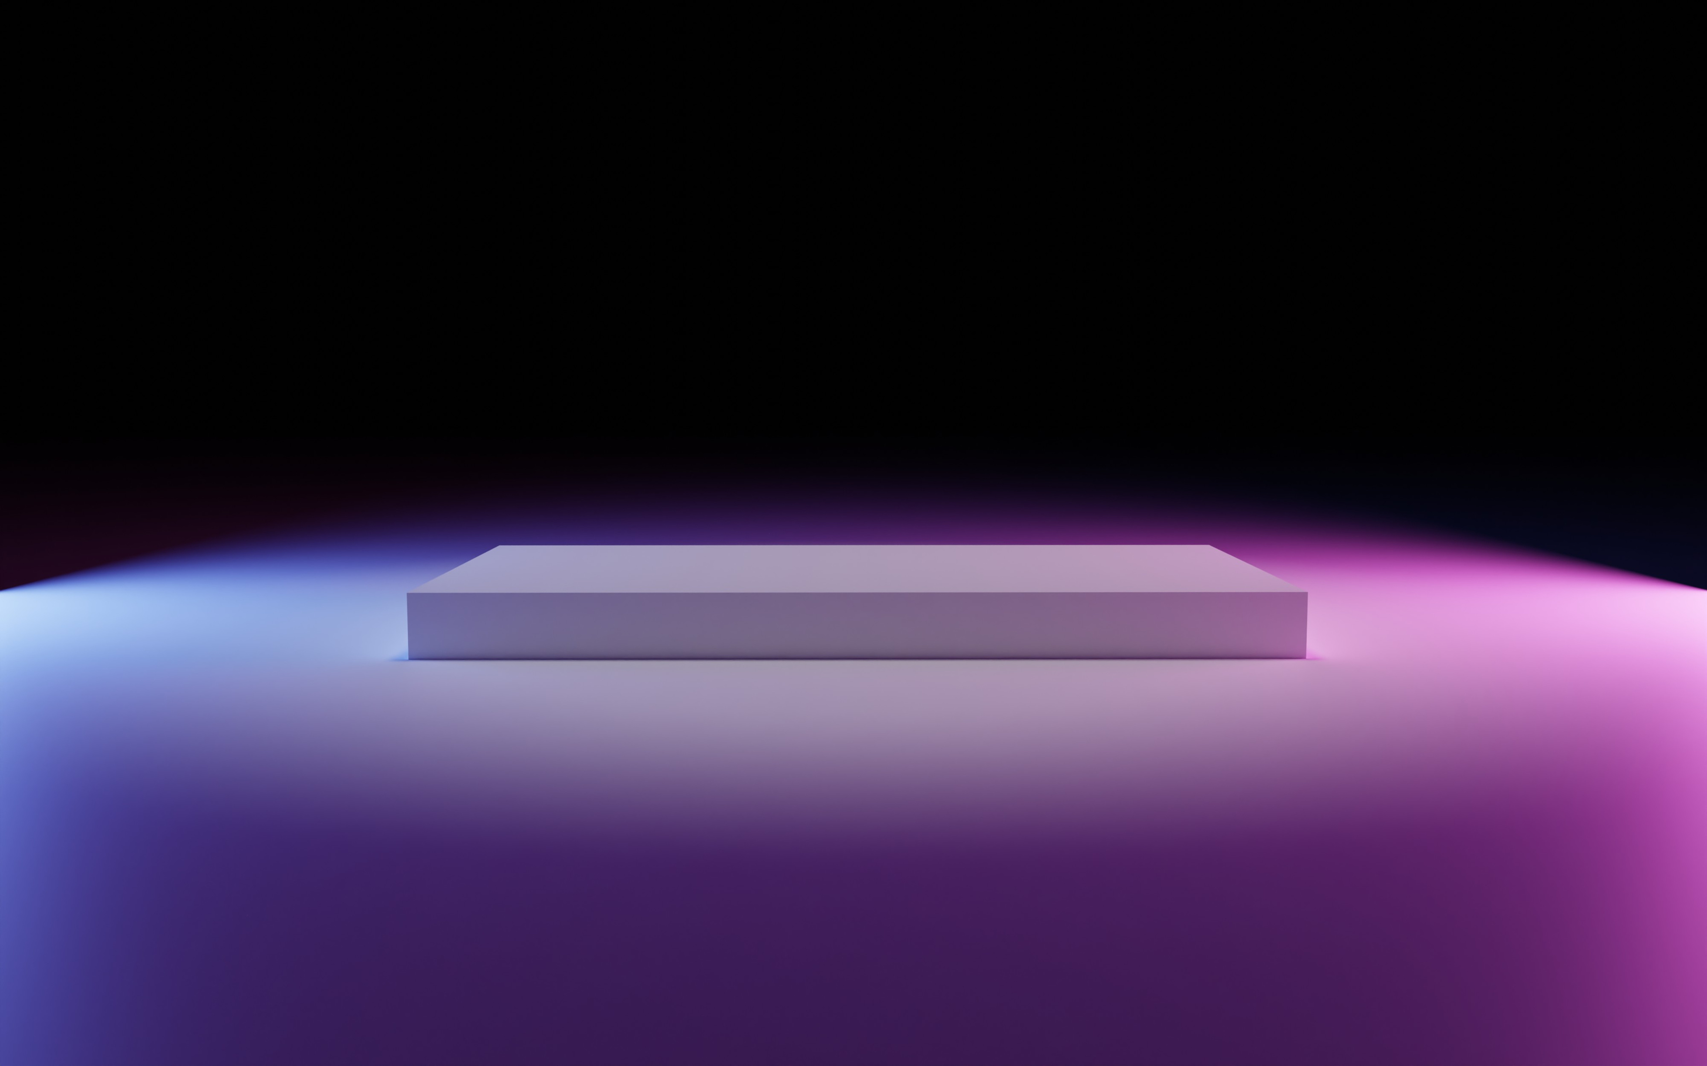


VIRTUAL CAMPUS TOUR
22BCA239
&
22BCA144

Slide 2

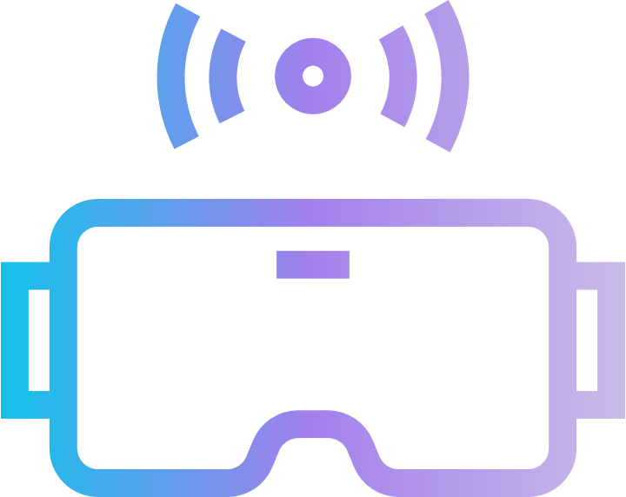

INDEX
Sr.NO |  | Subject | Page Redirect
1. |  | Project Profile & Company Profile
2. |  | Introduction to tools
3. |  | System Study
 | 3.1. | Existing System
 | 3.2. | Proposed System
 | 3.3. | Scope of the Proposed System
 | 3.4. | Aim and Objective of the Proposed System
 | 3.5. | Feasibility Study
 |  | Technical Feasibility
 |  | Economical Feasibility
Redirect
Redirect
Redirect
Redirect
Redirect
Redirect
Redirect
Redirect
Redirect
Redirect

Slide 3
INDEX
Sr.NO |  | Subject | Page Redirect
 |  | Operational Feasibility
 |  | Time Feasibility
4. |  | System Analysis
 | 4.2 | Use Case Diagram
 | 4.3 | Activity Diagram
5. |  | System Design
 | 5.1 | Screen Layouts
6. |  | System Testing
 |  | Testing Strategies
7. |  | Future Enhancement
8. |  | Bibliography/References
Redirect
Redirect
Redirect
Redirect
Redirect
Redirect
Redirect
Redirect
Redirect
Redirect
Redirect

Slide 4


1.Project Profile
Back To Main Index
Project Name: Virtual Campus Tour
Type of Application: 3D Interactive Application/Game
Project Description: The Virtual Campus Tour is an interactive 3D application designed to provide an immersive experience of our department. Users can explore the digital model of the campus, including classrooms, labs, a staffroom, and an auditorium. The application allows free movement and teleportation to different locations through a dedicated teleport page. This project enhances engagement and provides a realistic virtual tour for students, faculty, and visitors.
Team Size: 2
Front End: Unity (C#), Blender (for 3D models)
Back End: Not applicable (Standalone application)
Tools Used: Unity (C#), Blender, Visual Studio, Canva (for textures)

Slide 5
2.INTRODUCTION TO TOOLS
Back To Main Index
1. Blender
Blender is an open-source 3D modeling tool used for creating and designing the campus environment, including:
Buildings and Infrastructure: Constructing classrooms, labs, staffrooms, and the auditorium in a realistic 3D format.
Object Modeling: Designing desks, chairs, computers, whiteboards, and other elements to add detail to the environment.
Optimization: Ensuring models are lightweight and efficient to maintain smooth performance within Unity.

Slide 6
2. Unity (C
#)
Unity is a powerful and widely used game engine that allows developers to create interactive 3D environments. In this project, Unity played a crucial role in:
Player Movement: Implementing smooth navigation using C# scripts to allow the user to explore the virtual campus.
Teleportation System: Creating a teleportation feature to instantly move the player to specific locations like classrooms, labs, and the staffroom.
Door Interaction and Animations: Programming doors to open and close when a player interacts with them, adding a realistic feel to the environment.
Scene Management: Organizing different areas of the campus efficiently to optimize performance and provide a seamless experience.
Back To Main Index

Slide 7
3. Visual Studio (C
Visual Studio is the primary code editor used for writing and debugging C# scripts within Unity. It was essential for:
Writing Player Controls: Implementing scripts that manage player movement, teleportation, and interactions.
Handling Game Logic: Programming conditions for door animations, teleportation mechanics, and user interactions.
Debugging & Testing: Identifying and fixing errors to ensure a smooth user experience.
Back To Main Index

Slide 8
4. Canva
Canva is a graphic design tool used to enhance the visual quality of the Virtual Campus Tour. It played a role in:
Texture Design: Creating realistic textures for walls, floors, and other surfaces to improve the appearance of the 3D models.
User Interface (UI): Designing icons, buttons, and teleportation menus to make the application visually appealing and user-friendly.
Branding Elements: Adding labels, signage, and other graphical components to make the virtual campus more informative and engaging.
Back To Main Index

Slide 9
3. SYSTEM STUDY
Back To Main Index
3.1 Existing System
Traditionally, campus tours are conducted in person, requiring students, faculty, and visitors to physically visit the institute. This system has several limitations:
Time-Consuming: Visitors must allocate time to physically explore the campus.
Limited Accessibility: Not everyone can visit due to distance or scheduling conflicts.
Lack of Interactivity: Physical tours do not offer features like instant teleportation or detailed exploration at the user’s convenience.
Resource Intensive: Requires staff or student volunteers to guide visitors.

Slide 10
3.2 Proposed System
Back To Main Index
The Virtual Campus Tour application provides an interactive and immersive way to explore the campus digitally. Key improvements over the existing system include:
3D Interactive Experience: Users can explore classrooms, labs, the staffroom, and the auditorium in a fully rendered 3D environment.
Player Movement & Teleportation: Players can move freely or teleport to specific locations instantly using a teleport page.

Slide 11
3.2 Proposed System
Back To Main Index
Realistic Interactions: The system includes door animations and interactive elements to enhance engagement.
Accessible Anytime, Anywhere: Users can experience the campus tour remotely, overcoming geographical barriers.
No Human Guides Required: Eliminates the need for staff or students to conduct physical tours, saving time and resources

Slide 12
3.3 Scope of the Proposed System
Back To Main Index
The Virtual Campus Tour aims to provide an interactive and immersive way for users to explore the campus digitally. It is designed to be user-friendly, accessible, and engaging. The system’s scope includes:
Virtual Exploration: Users can navigate the campus freely and teleport to specific locations such as classrooms, labs, the staffroom, and the auditorium.
3D Realism: The environment is modeled in 3D using Blender, with realistic textures designed in Canva.

Slide 13
3.3 Scope of the Proposed System
Back To Main Index
Interactive Features: Doors are animated and interactive, allowing users to experience a dynamic environment.
Remote Accessibility: The system can be accessed from anywhere, reducing the need for physical campus visits.
Enhanced Engagement: The virtual tour can be used for student orientation, promotional purposes, and academic events

Slide 14
3.4 Aim and Objective of the Proposed System
Aim:
The aim of this project is to develop a Virtual Campus Tour application that provides a 3D interactive experience for users to explore the department’s infrastructure in a realistic and engaging manner.
Objectives:
1. Create an Immersive Experience: Develop a high-quality 3D campus environment with interactive elements.
2. Improve Accessibility: Enable students, faculty, and visitors to explore the campus remotely at any time.
Back To Main Index

Slide 15
3.4 Aim and Objective of the Proposed System
3. Enhance User Interaction: Implement player movement, door animations, and teleportation for seamless navigation.
4. Optimize Performance: Ensure the application runs smoothly with efficient 3D models and well-structured code.
5. Reduce Dependence on Physical Tours: Provide an alternative to traditional campus visits, saving time and resources.
Back To Main Index

Slide 16
3.5 Feasibility Study
Back To Main Index
A feasibility study evaluates the viability of the proposed Virtual Campus Tour system based on different criteria:
1. Technical Feasibility:
The system is developed using Unity (C#) for game development, Blender for 3D modeling, Visual Studio for scripting, and Canva for textures.
All required technologies are accessible and supported by the development team.
The project does not require a backend, making implementation straightforward.

Slide 17
3.5 Feasibility Study
Back To Main Index
Economic Feasibility:
The project primarily uses open-source or free-to-use tools like Unity, Blender, and Canva, making it cost-effective.
No additional hardware is required beyond a standard PC for development and testing.
Reduces the need for printed brochures or physical guides, saving institutional costs.

Slide 18
3.5 Feasibility Study
Back To Main Index
3. Operational Feasibility:
The system provides an easy-to-use interface for users, with intuitive movement and teleportation controls.
It meets the needs of students, faculty, and visitors by offering a realistic and detailed virtual experience.
No additional training is required for users, as the system is self-explanatory

Slide 19
3.5 Feasibility Study
Back To Main Index
4. Time Feasibility
The development timeline is manageable, given the available resources and team expertise.
The project can be expanded in future iterations with additional features like VR support.

Slide 20
4. SYSTEM ANALYSIS
Back To Main Index
4.1 Requirements Specification
The traditional campus tour process requires physical presence, making it difficult for students, faculty, and visitors to explore the campus remotely. The existing system lacks interactivity and accessibility, leading to challenges such as:
System Modules:
Start Screen: Interactive UI with magnifying glass cursor and hover effects.
Explore Mode: Free movement in the virtual campus.
Teleport System: Direct navigation to locations.
Sound Settings: Background music and footstep control.
Exit System: Proper program termination.

Slide 21
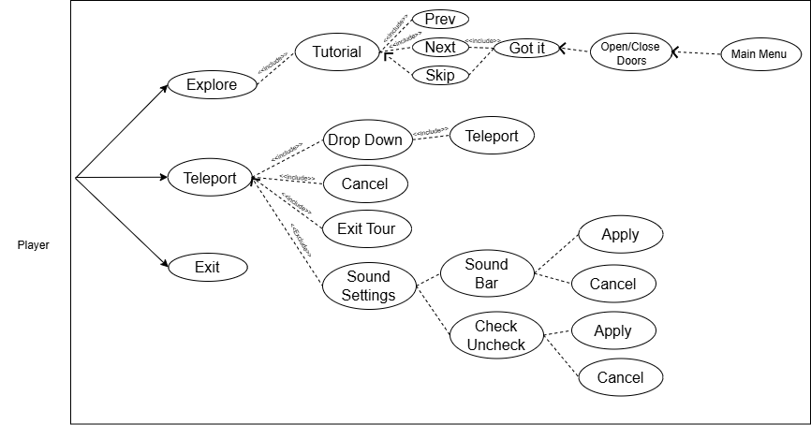
4.2 Use Case Diagram
Back To Main Index
.

Slide 22
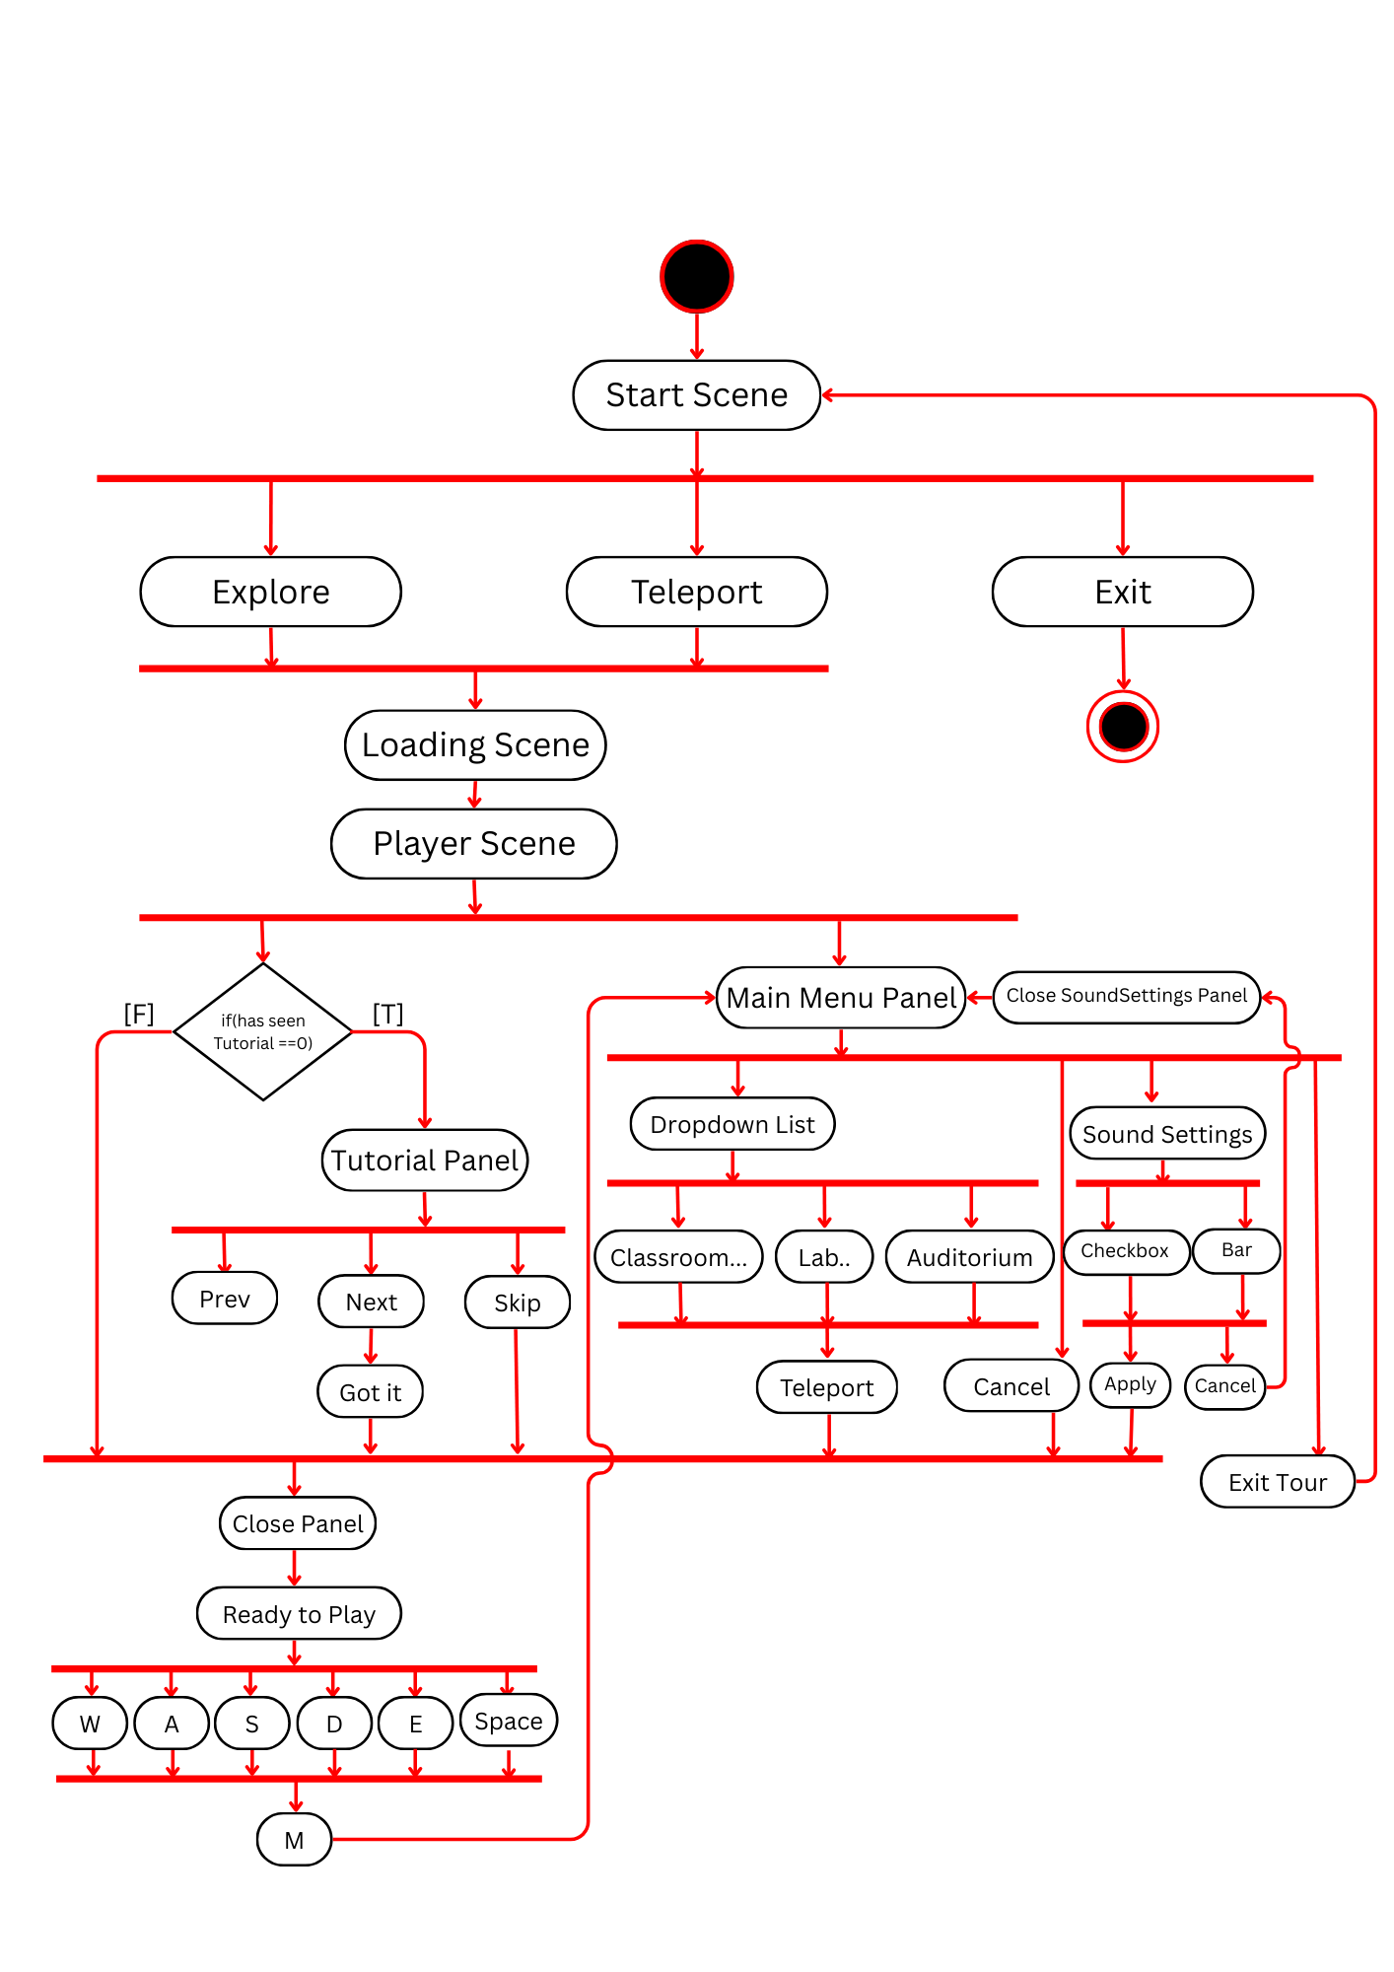
4.3 Activity Diagram
Back To Main Index
.

Slide 23
4.3 Activity Diagram
Back To Main Index
1. StartScene
.

Slide 24
4.3 Activity Diagram
Back To Main Index
2. Player Scene & Main Menu Panal
.

Slide 25
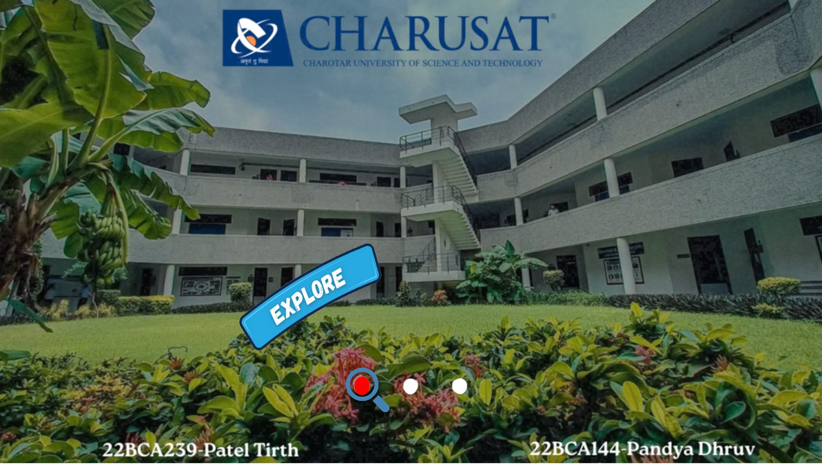
5. Screen Layout
Back To Main Index
1. Start Scene

Slide 26
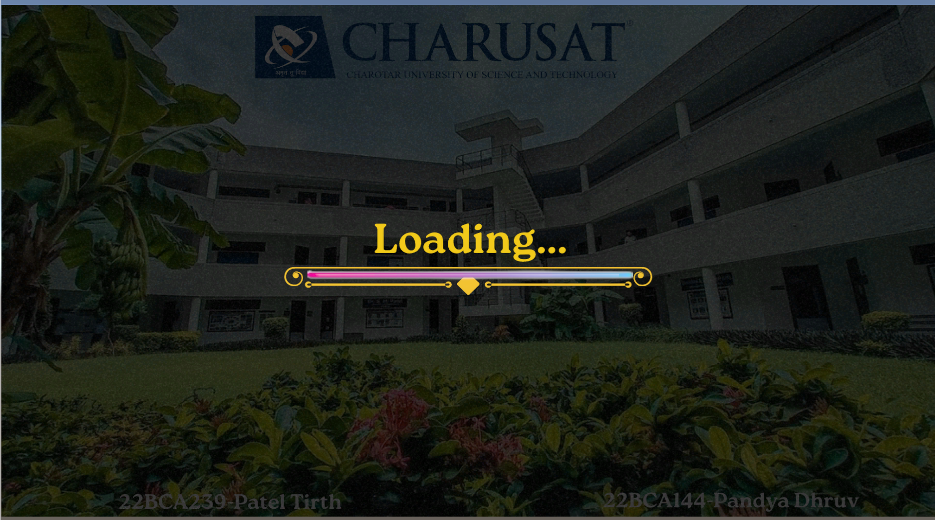
5. Screen Layout
Back To Main Index
2. Loading Scene

Slide 27
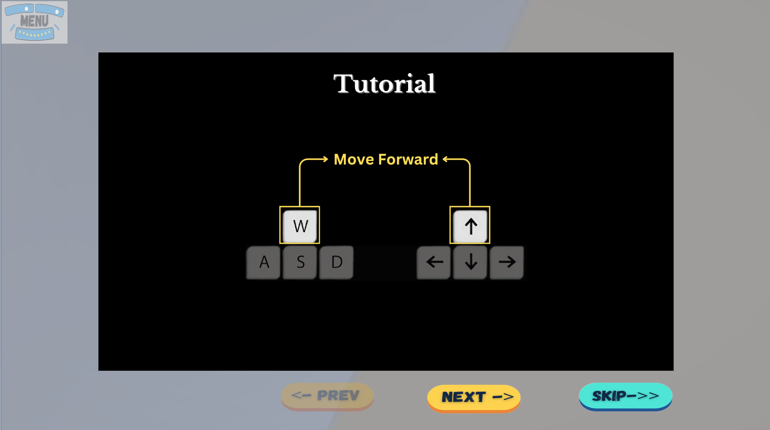
5. Screen Layout
Back To Main Index
3. Tutorial Scene-1

Slide 28
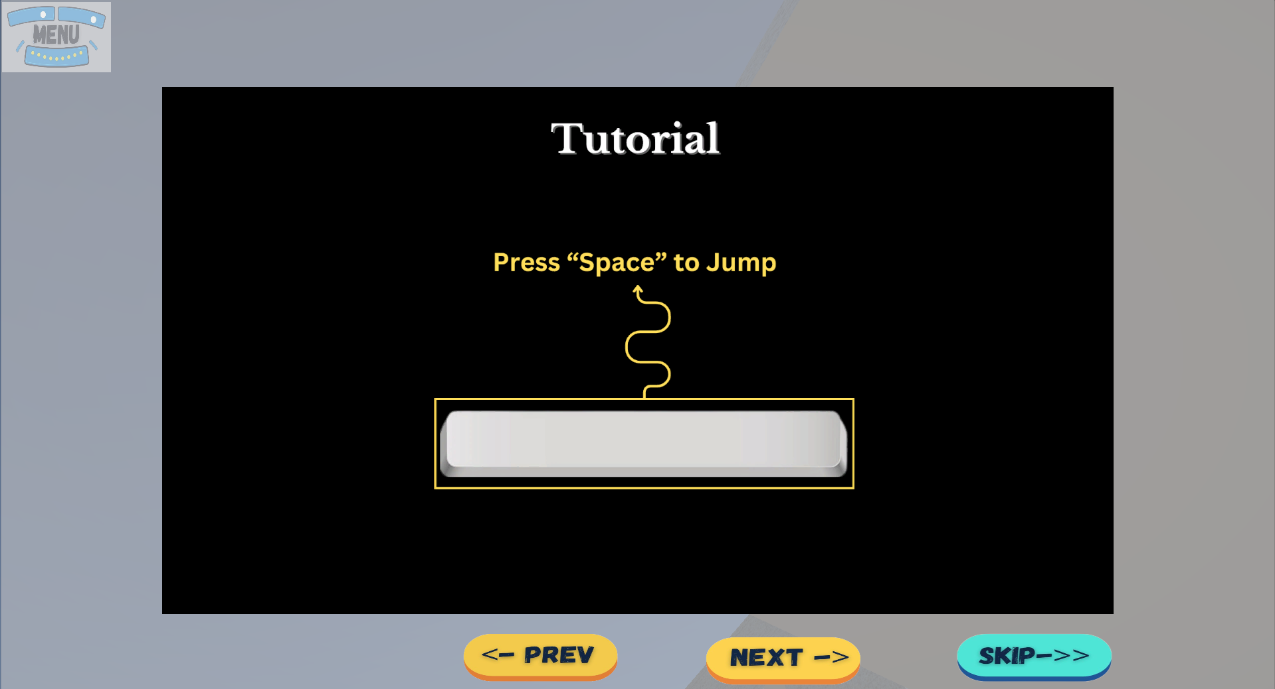
5. Screen Layout
Back To Main Index
4. Tutorial Scene-2

Slide 29
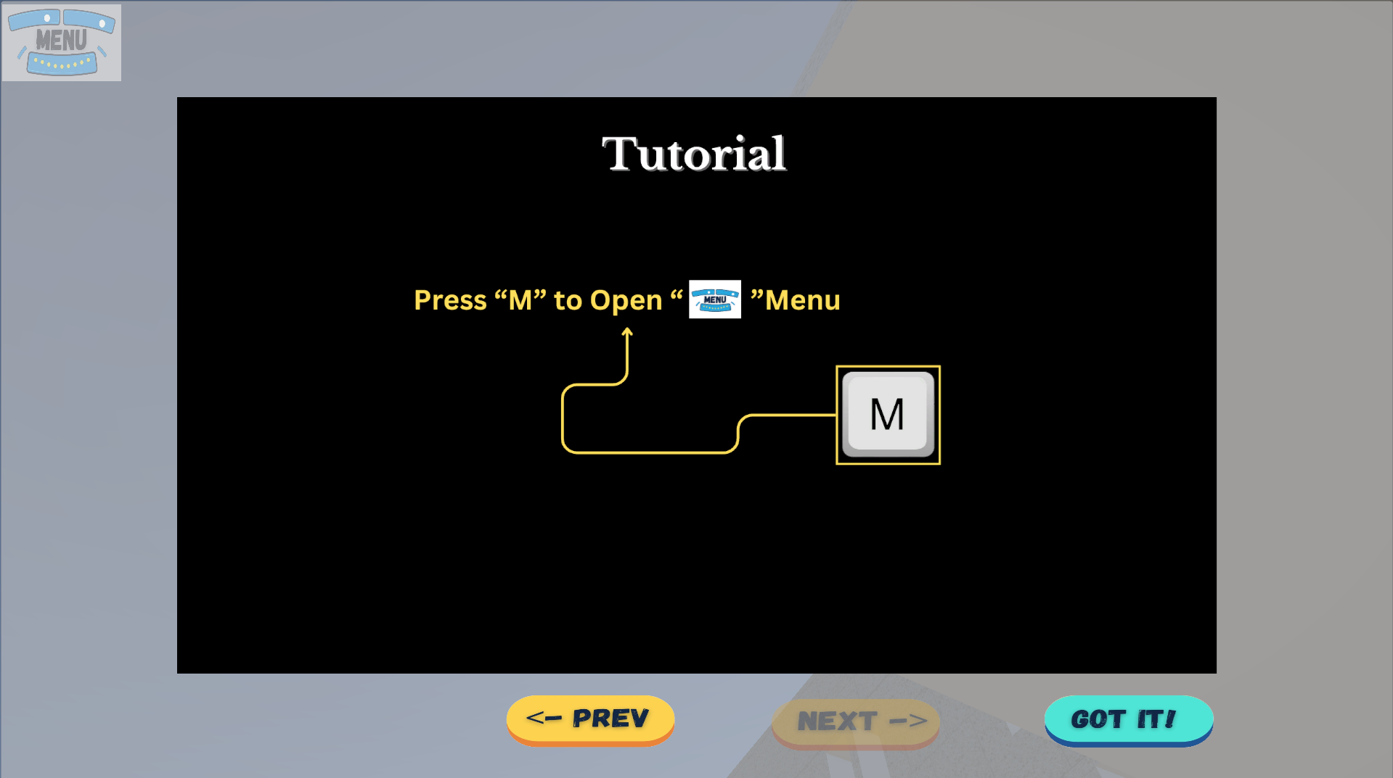
5. Screen Layout
Back To Main Index
5. Tutorial Scene-3

Slide 30
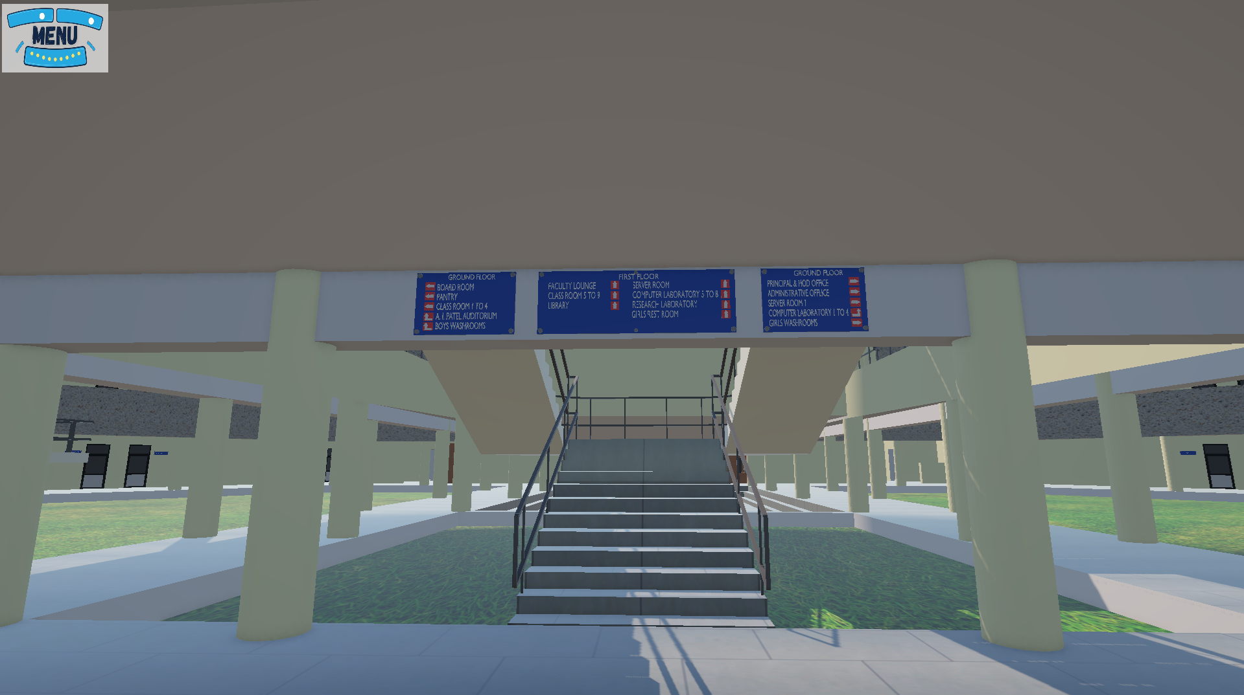
5. Screen Layout
Back To Main Index
6. Player Scene

Slide 31
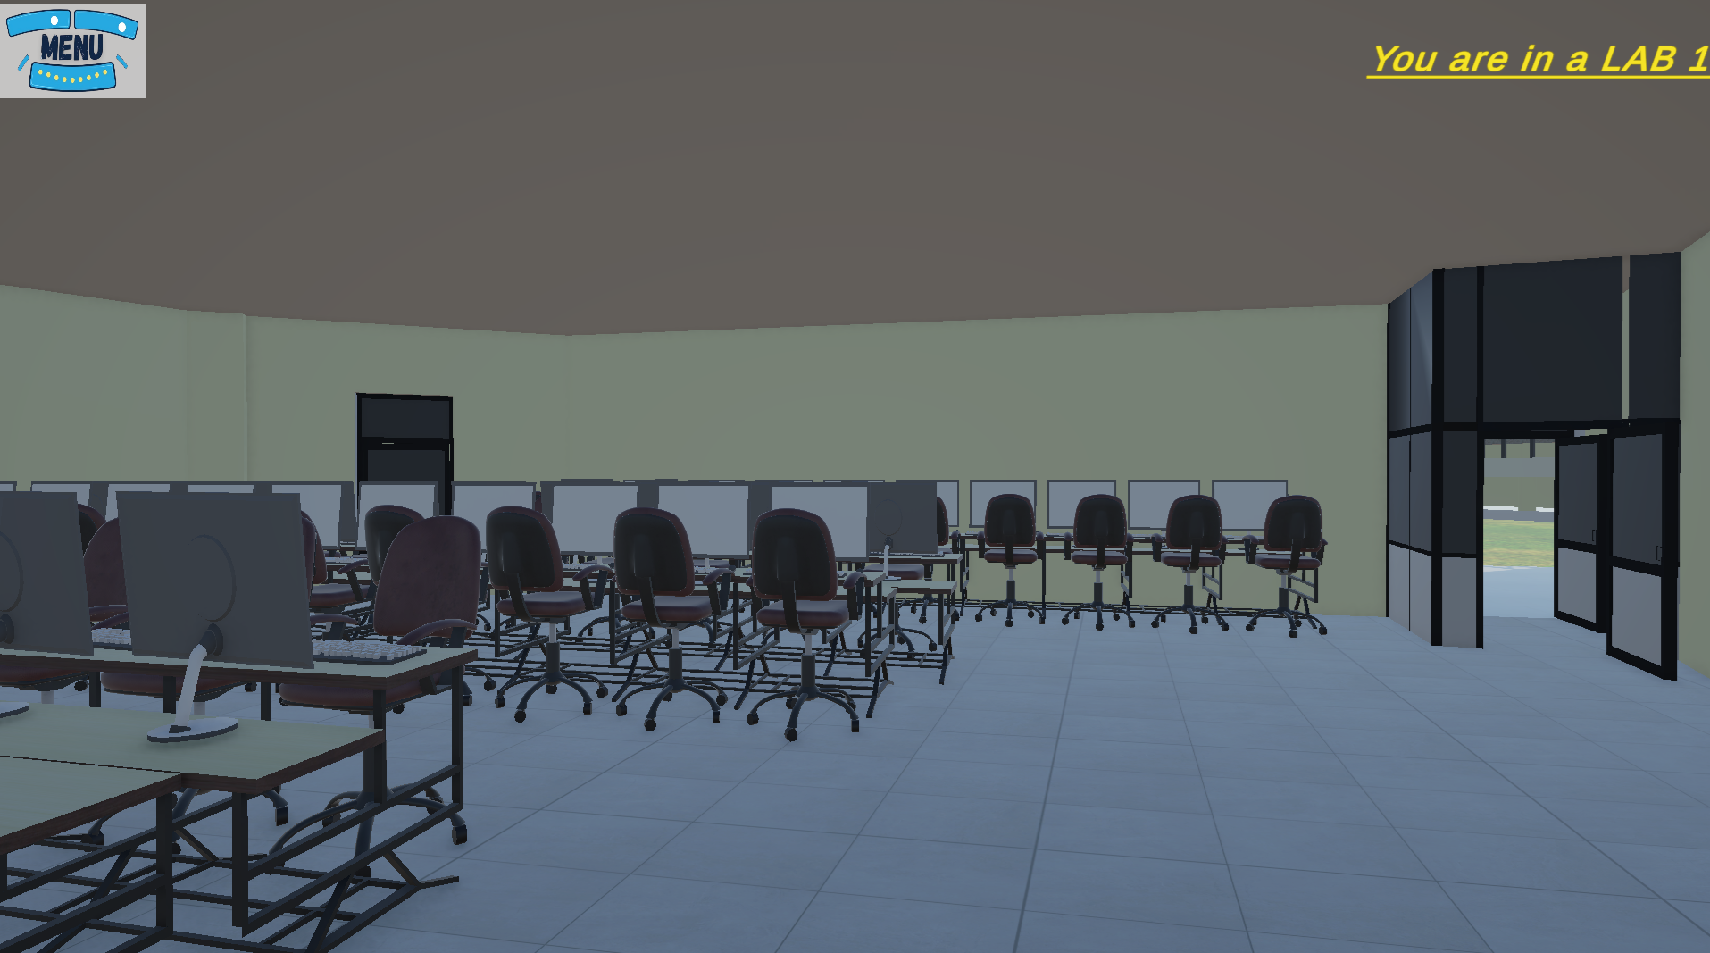
5. Screen Layout
Back To Main Index
7. Lab

Slide 32
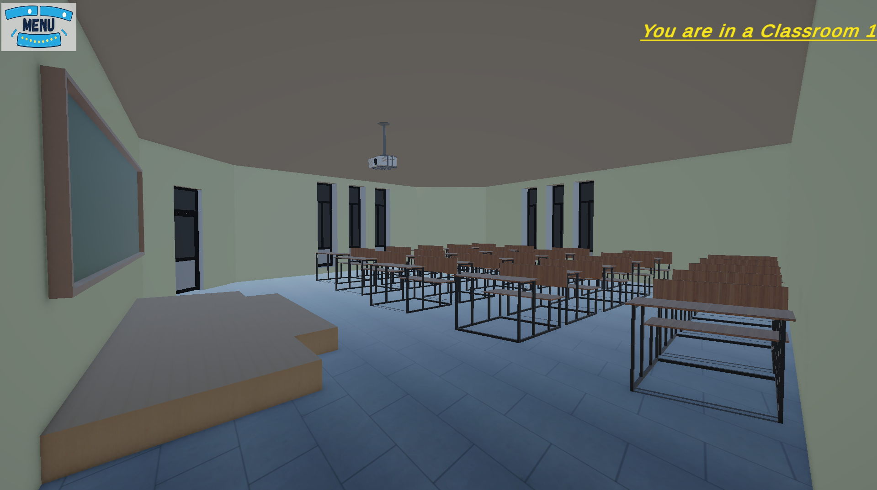
5. Screen Layout
Back To Main Index
8. Classroom

Slide 33
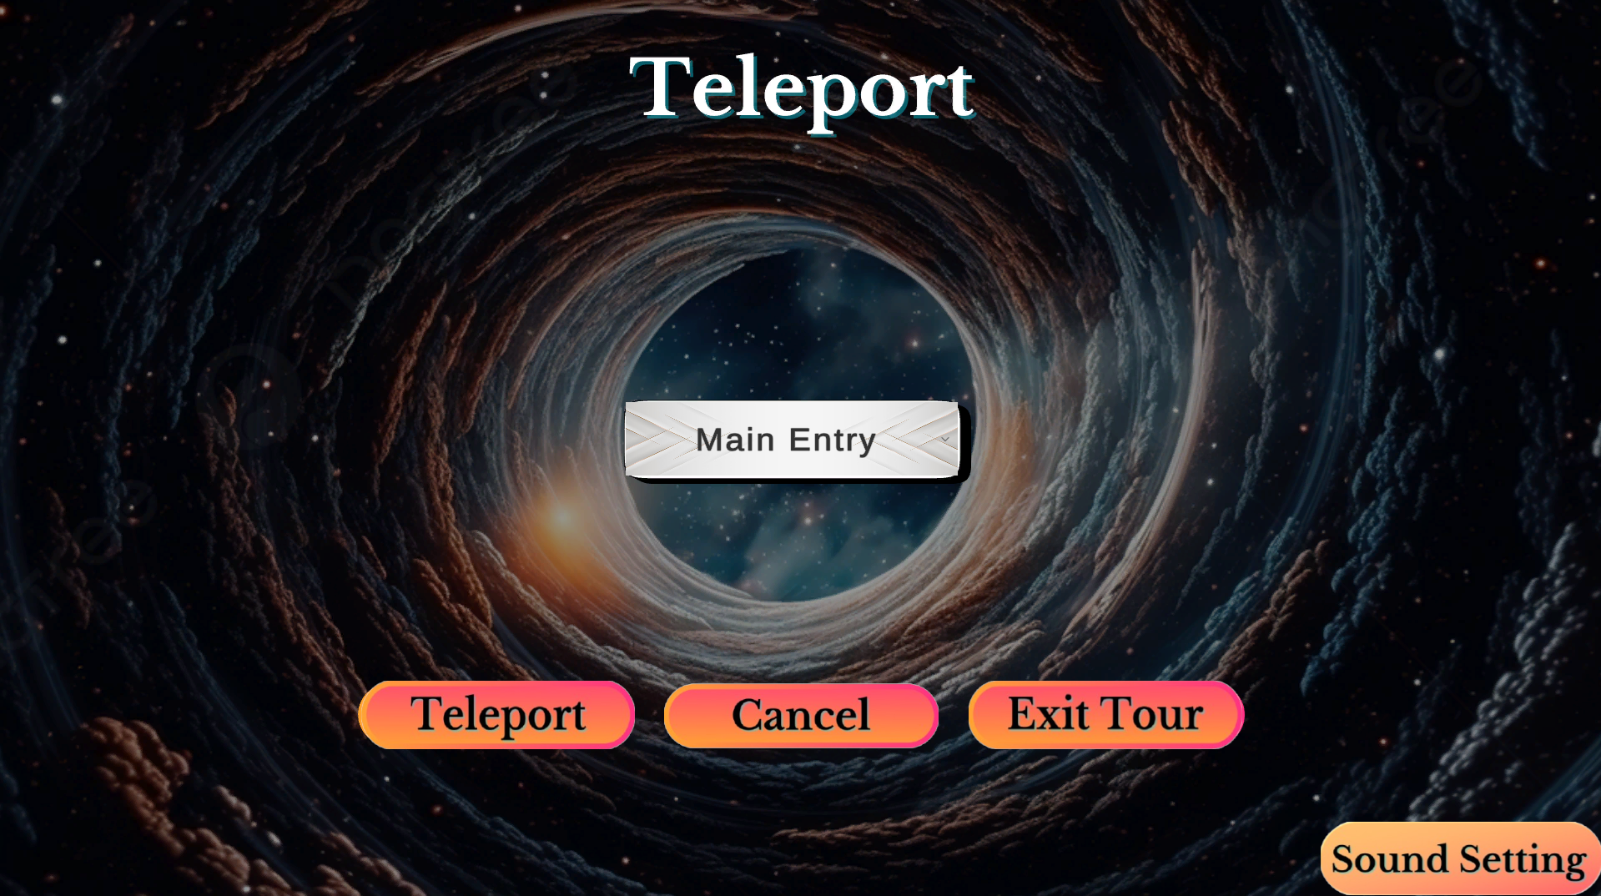
5. Screen Layout
Back To Main Index
9. Teleport Menu-1

Slide 34
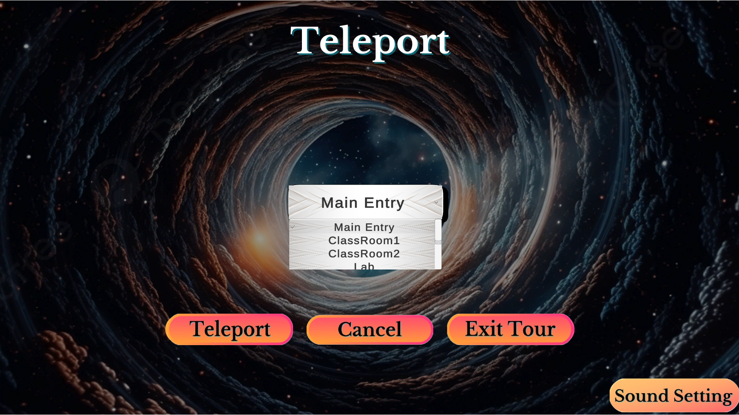
5. Screen Layout
Back To Main Index
10. Teleport Menu-2

Slide 35
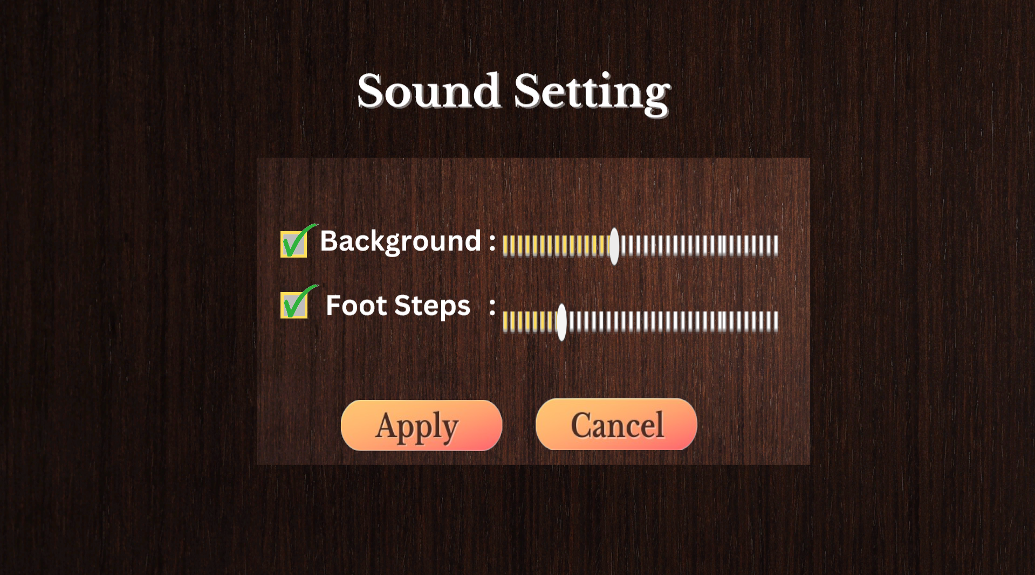
5. Screen Layout
Back To Main Index
11. Sound Settings-1

Slide 36
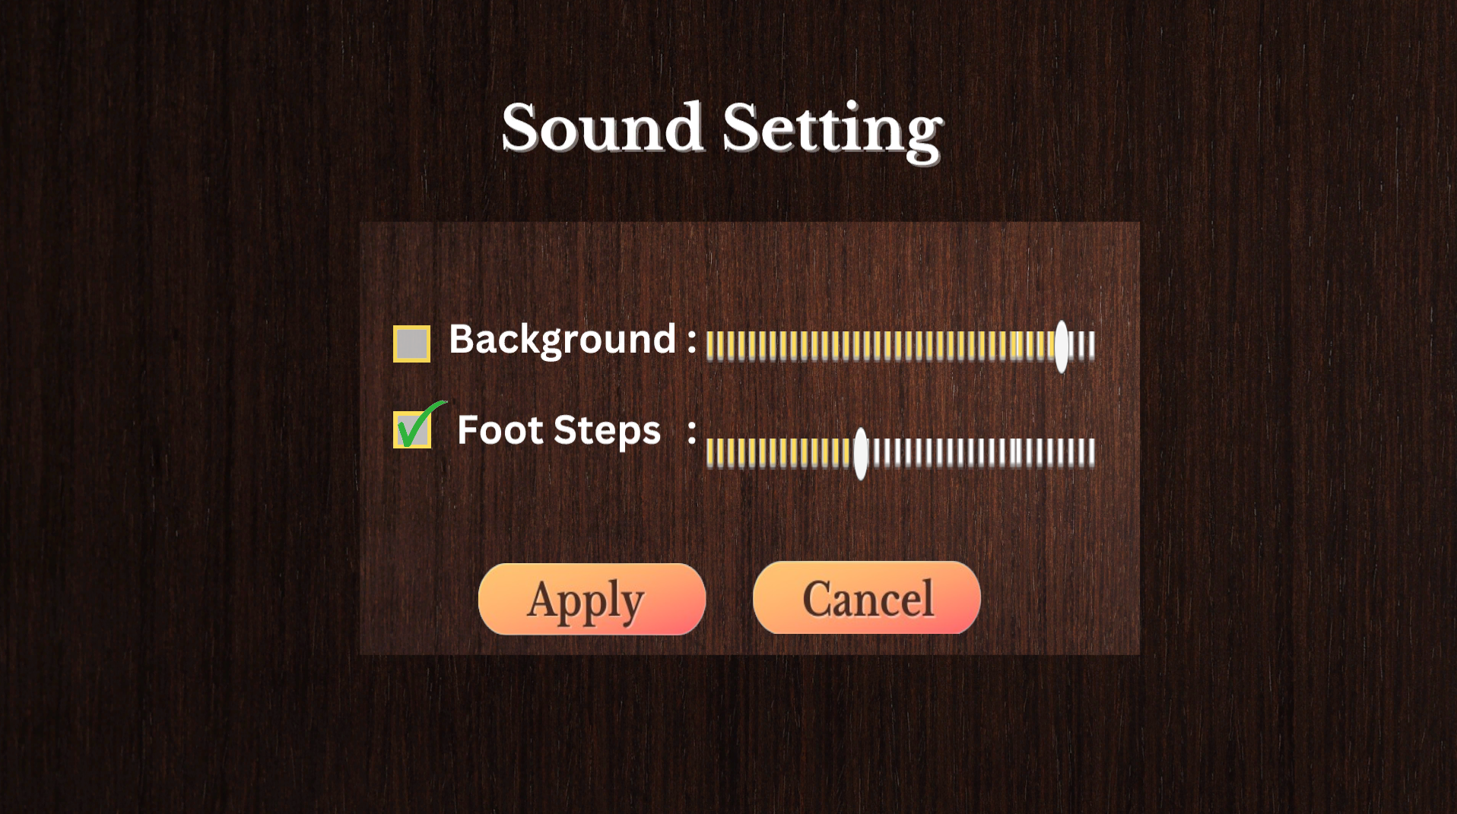
5. Screen Layout
Back To Main Index
12. Sound Settings-2

Slide 37

6. System Testing
Back To Main Index
System testing is a crucial phase where the entire Virtual Campus Tour application is tested to ensure it meets the functional and non-functional requirements. Various testing strategies are implemented to validate individual components, integration, functionality, and overall system behavior.
6.1 Unit Testing
Objective: To test individual components or modules to ensure they work as expected.
Scope: Each function, class, or module of the system is tested separately before integration.
Bugs are identified at an early stage, reducing debugging time later.

Slide 38
6.1.1 Unit Testing
Back To Main Index
Examples:
1.Player Movement:
Test if the player can move forward, backward, left, and right smoothly without glitches.
Ensure movement speed remains consistent across different environments.
2.Door Interaction (Pressing "E"):
Verify that doors open and close correctly upon pressing "E".
Ensure that doors remain interactive even after teleporting.

Slide 39
6.1.1 Unit Testing
Back To Main Index
Examples:
3.Teleportation Feature:
Check if the teleport button moves the player to the correct selected location.
Ensure teleportation doesn’t cause unexpected lag or graphical errors.
4.Sound Settings:
Test whether enabling/disabling footsteps and background music works correctly.
Verify that volume adjustments apply correctly when the "Apply" button is clicked.

Slide 40
6.1.2 Integration Testing
Back To Main Index
Objective: To ensure that different modules and components interact correctly when combined.
Scope:
Focuses on data flow between modules.
Ensures features function properly when combined.
Examples:
1.Teleportation + Sound Settings
Ensure that sound settings persist even after teleporting to another location.
2.Explore Mode + Doors Interaction
Test if doors remain interactable when the player switches from Teleport Mode back to Explore Mode.

Slide 41
6.1.2 Integration Testing
Back To Main Index
3. Start Screen → Exploration → Teleportation
Check if transitioning between these modes functions smoothly.
Ensure no game-breaking bugs occur when switching between them.
4.Exit Tour Button
Verify that clicking "Exit Tour" correctly returns the player to the Start Screen without glitches.

Slide 42
6.1.3 Functional Testing
Back To Main Index
Objective: To validate that the application performs according to specified requirements.
Scope:
Tests are based on the Virtual Campus Tour’s functional requirements.
Ensures all features work as expected.
Examples:
1. Teleportation Accuracy:
Verify that selecting a location from the dropdown list correctly teleports the player to that location.

Slide 43
6.1.3 Functional Testing
Back To Main Index
Examples:
2. Tutorial Skipping:
Ensure the "Got-it" button allows players to skip the tutorial.
3.Start Screen Hover Effects:
Check that hovering over Explore, Teleport, and Exit changes the dot colors and displays labels.
4.Exit Button Functionality:
Ensure clicking "Exit" on the start screen completely stops the program.

Slide 44
6.1.4 System Testing
Back To Main Index
Objective: To test the entire system as a whole, ensuring all components work together seamlessly.
Scope:
Verifies the complete end-to-end flow of the application.
Ensures the system meets all performance and usability requirements.
Examples:
1. Complete User Journey Test:
Start at Start Screen → Select Explore Mode → Interact with Doors → Open Teleport Menu (M key) → Adjust Sound Settings → Teleport to a Location → Exit Tour → Restart the Tour.

Slide 45
6.1.4 System Testing
Back To Main Index
2.Performance Testing:
Ensure smooth frame rates and no major lag spikes during gameplay.
3.Error Handling:
If an invalid teleport destination is selected, the system should display an error message instead of crashing.

Slide 46
6.1.5 Regression Testing
Back To Main Index
Objective: To ensure that new changes (bug fixes, optimizations) do not introduce new issues.
Scope:
Run previously successful test cases again after making updates.
Examples:
1.Teleportation Bug Fixes:
If a teleportation glitch is fixed, re-test door interactions, movement, and sound settings to ensure they are not affected.

Slide 47

6.1.5 Regression Testing
Back To Main Index
Examples:
2. Sound Setting Adjustments:
If sound settings are modified, verify that all volume controls still work properly.
3.Exploration Mode Changes:
If movement speed is adjusted, test again to confirm doors and teleportation still function correctly.

Slide 48

6.2 TEST CASES:
Back To Main Index
1 . Player Movement
TC ID | Test Case Description | Test Steps | Expected Result | Status
TC_01 | Verify player can move using WASD keys | 1. Launch the game 2. Press W/A/S/D keys | The player moves in the respective direction | Pass
TC_02 | Check if movement speed is consistent | 1. Move forward for 5 seconds 2. Observe speed in different locations | The speed remains the same in all areas | Pass
TC_03 | Verify player can jump using the Spacebar | 1. Press the Spacebar while standing 2. Observe player movement | The player should jump and land smoothly | Pass
TC_04 | Ensure player cannot jump infinitely (double-jump prevention) | 1. Press the Spacebar twice quickly 2. Observe player behavior | The player should not perform a second jump mid-air | Pass
. Player Movement

Slide 49
6.2 TEST CASES:
Back To Main Index
2. Door Interaction
TC ID | Test Case Description | Test Steps | Expected Result | Status
TC_05 | Verify door opens when pressing "E" | 1. Approach a door 2. Press "E" | The door opens smoothly | Pass
TC_06 | Verify door closes when pressing "E" again | 1. Open the door 2. Press "E" again | The door closes properly | Pass
TC_07 | Check if door interaction works after teleporting | 1. Teleport to a new location 2. Try opening/closing a door | Doors should still be interactable | Pass
. Player Movement

Slide 50
6.2 TEST CASES:
Back To Main Index
3. Teleportation Functionality
TC ID | Test Case Description | Test Steps | Expected Result | Status
TC_08 | Verify teleport button takes the player to the selected location | 1. Open Teleport Menu 2. Select a location 3. Click "Teleport" | The player is moved to the correct location | Pass
TC_09 | Check if canceling teleportation returns to the game | 1. Open Teleport Menu 2. Click "Cancel" | The player remains in the current location | Pass
TC_010 | Ensure "Exit Tour" button returns to the start screen | 1. Open Teleport Menu 2. Click "Exit Tour" | The game returns to the Start Screen | Pass
. Player Movement

Slide 51
6.2 TEST CASES:
Back To Main Index
4. Sound Settings
TC ID | Test Case Description | Test Steps | Expected Result | Status
TC_11 | Verify enabling/disabling footsteps sound | 1. Open Sound Settings 2. Toggle footsteps ON/OFF 3. Click "Apply" | Footsteps sound changes accordingly | Pass
TC_12 | Check if background music volume adjusts correctly | 1. Open Sound Settings 2. Adjust background music volume 3. Click "Apply" | Background music volume is updated | Pass
TC_13 | Validate "Cancel" button discards changes | 1. Open Sound Settings 2. Change volume 3. Click "Cancel" | Changes are not applied | Pass
. Player Movement

Slide 52
Back To Main Index
6.2 TEST CASES:
5. General Functional Testing
TC ID | Test Case Description | Test Steps | Expected Result | Status
TC_14 | Verify hovering over Start Screen buttons highlights them | 1. Hover over "Explore", "Teleport", "Exit" | The button highlights and shows text | Pass
TC_15 | Check if tutorial pages are skippable | 1. Start a new session 2. Click "Got-it" on tutorial pages | Tutorial pages disappear | Pass
TC_16 | Ensure "Exit" button closes the game | 1. Click "Exit" on the start screen | The game should close completely | Pass
. Player Movement

Slide 53
7.FUTURE ENHANCEMENT
Back To Main Index
1. Texture Improvement:
Improving textures by replacing old texture with higher quality textures
2. Upgrade User Interface:
Improving UI Elements like Dropdown Menu, Buttons, Background Images,etc.
3. Adding Features:
Adding Features like Getting Achivements by just exploring the areas, and adding some hidden achivements for adding more Chaos.
. Player Movement

Slide 54
7.FUTURE ENHANCEMENT
Back To Main Index
4. Adding More Models:
Adding More Models like Fan, AC, More Detailed Labels.
5. Adding More Interactions:
Adding More user interactions like On & Off the AC.
6. Bug Fixing:
Fixing all type of bugs occuring on system.
. Player Movement

Slide 55
8.BIBLOGRAPHY/REFERENCES
Back To Main Index
W3School
https://www.w3schools.com/
(For Understanding C# Components Deeply)
2. YouTube Tutorials
https://youtu.be/4haAdmHqGOw?si=NuC3MPIyZNsll0Lk
(For understanding modeling in blender)
https://youtube.com/playlist?list=PLA-xaldQ72rwccxt4VR4sbM6Amq0hz62X&si=flALuJUv2RMUYpWq
(For Understanding Player Moment, Camera Control, Door Animation)
https://youtu.be/NtTGq2tomqI?si=MXKNhg088FPit7-6
(For understanding & Developing Bench objects)
. Player Movement

Slide 56
8.BIBLOGRAPHY/REFERENCES
Back To Main Index
5. Canva – Graphic and UI Design Resources https://www.canva.com/ (Used for designing textures and UI assets for a polished interface)
6. Free3D & Unity Asset Store https://www.free3d.com/ https://assetstore.unity.com/ (Used to explore and integrate 3D models and environmental props)
. Player Movement

Slide 57
THANK YOU!

